Slide 1
Windows OS: Git Installation
Step by Step
Notes:
Made with <3 by Jeffrey Hinkle

Slide 2
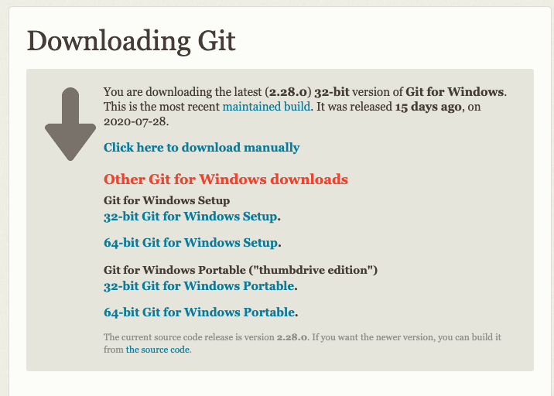
Step 1: Git’s download page for Windows OS - choose 32-bit or 64-bit option
Notes:
https://git-scm.com/download/win
on Windows 10, head to Settings > System > About. Under the Device specifications header, next to System type, you’ll see if Windows and your processor are 32-bit or 64-bit

Slide 3
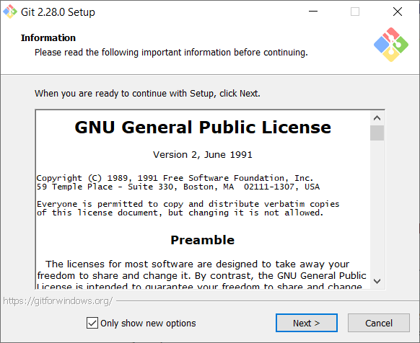
Step 2: Open the downloaded file - on the license prompt, click “Next” to accept
Notes:
You can either click the downloaded file at the bottom of your browser to open finder, or navigate to your downloads folder
It may open a window asking if you want to allow this application to make changes to your device, click “Yes”

Slide 4
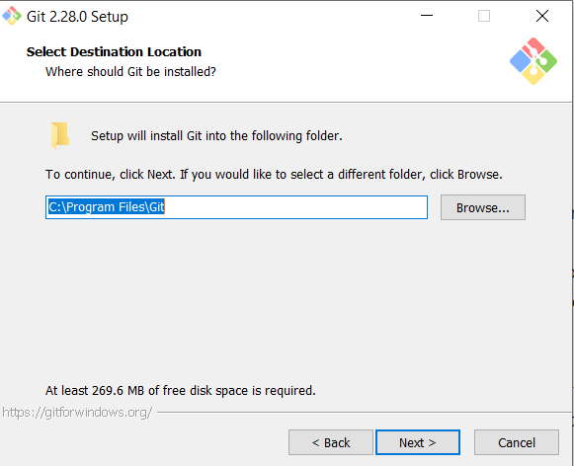
Step 3: Select the installation destination folder (default is recommended)

Slide 5
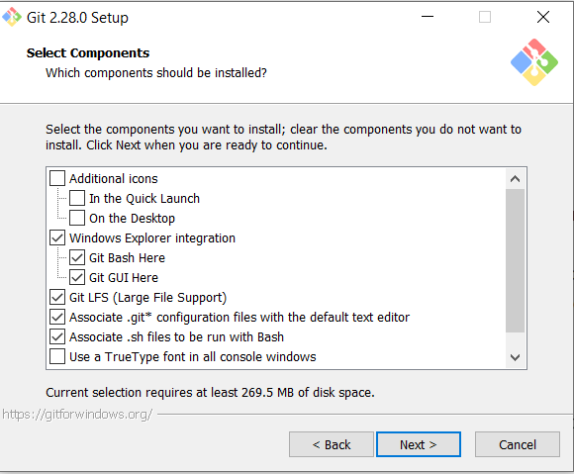
Step 4: Select components - keep the “Windows Explorer integration” options
Notes:
The other default options are recommended

Slide 6
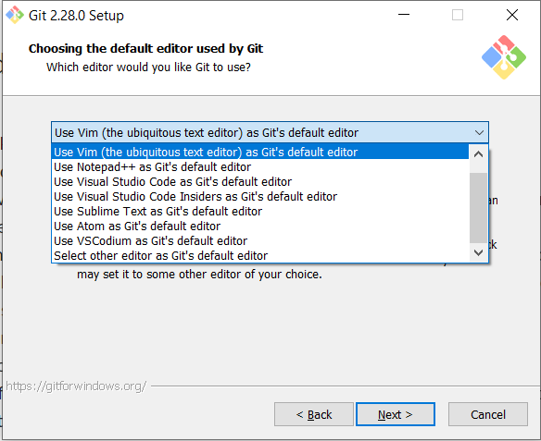
Step 5: Choose Nano or Visual Studio Code if you have not used an editor before
Notes:
Choose a default editor that you are comfortable with, or choose either Nano or Visual Studio Code if you have not used an editor before
If you know or have used vi/vim, feel free to use it (otherwise it is not recommended)
You must have the editor installed to continue. You can set a default now and change it later.

Slide 7
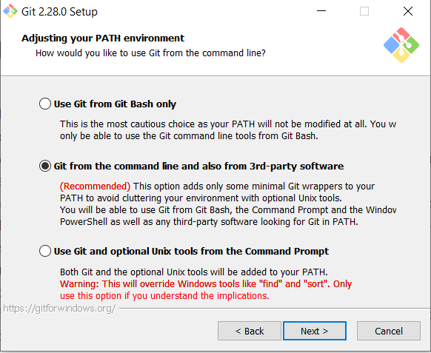
Step 6: Adjust the PATH environment - second option is recommended
Notes:
The first option is also fine, as you’ll mainly be using Git from the new “Git Bash” program that is being installed, but the second option is ideal as it’ll give you the option of using it through either Git Bash or the Windows Command Prompt in the future if you wish

Slide 8
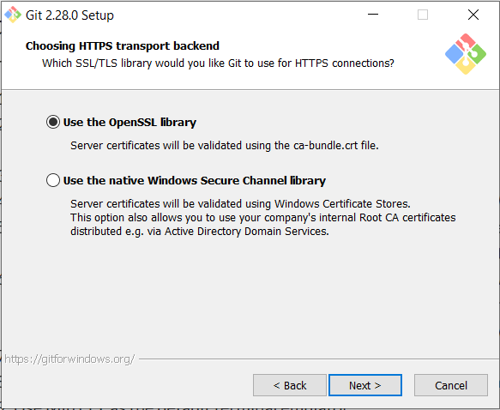
Step 7: Choose the HTTPS transport backend - choose OpenSSL library

Slide 9
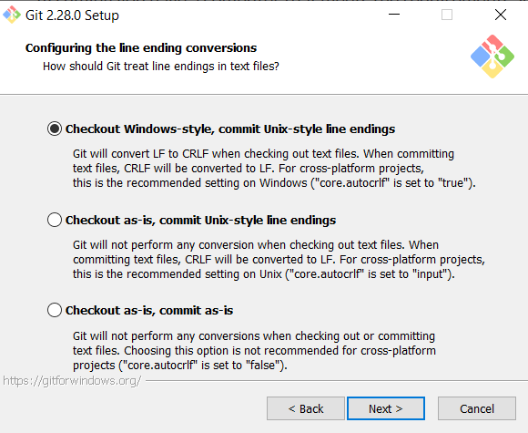
Step 8: Configure line ending conversions - select the default option

Slide 10
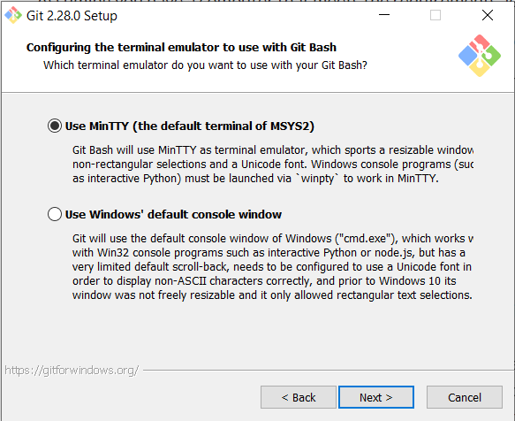
Step 9: Configure the terminal emulator - choose MinTTY

Slide 11
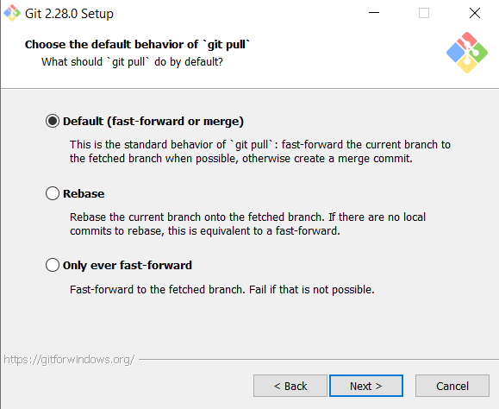
Step 10: Choose “Default” as the default behavior of ‘git pull’

Slide 12
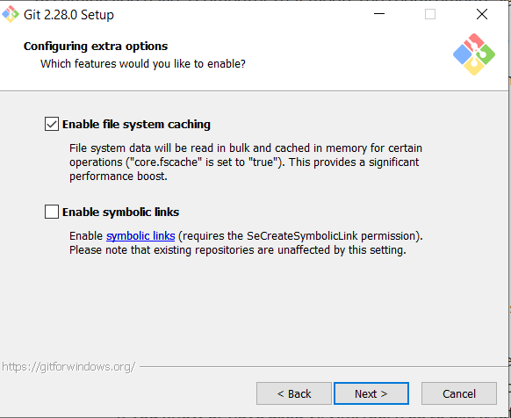
Step 11: Configure extra options to enable file system caching

Slide 13
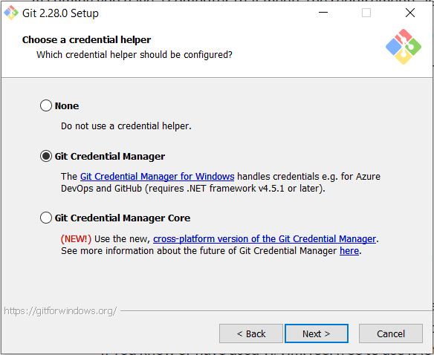
Step 12: Choose Git Credential Manager as the credential helper

Slide 14
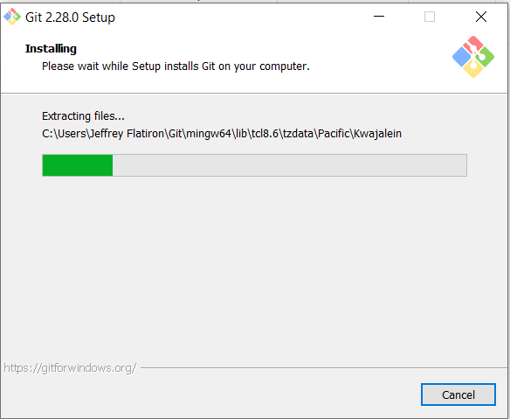
Step 13: Install

Slide 15
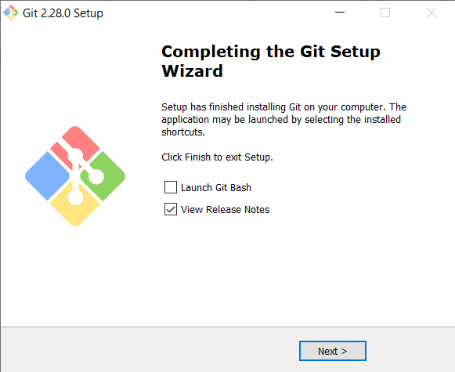
Step 14: Installation Complete - exit Setup (do not need to view release notes)

